Slide 1
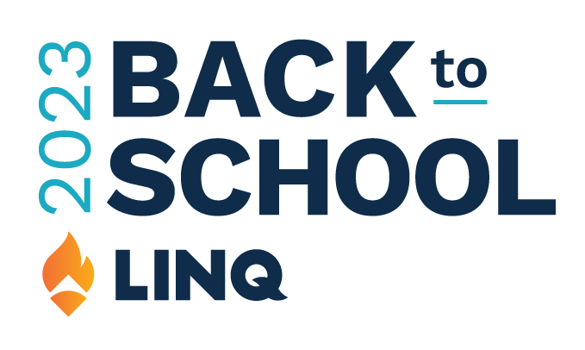
Social Media Toolkit

Slide 2
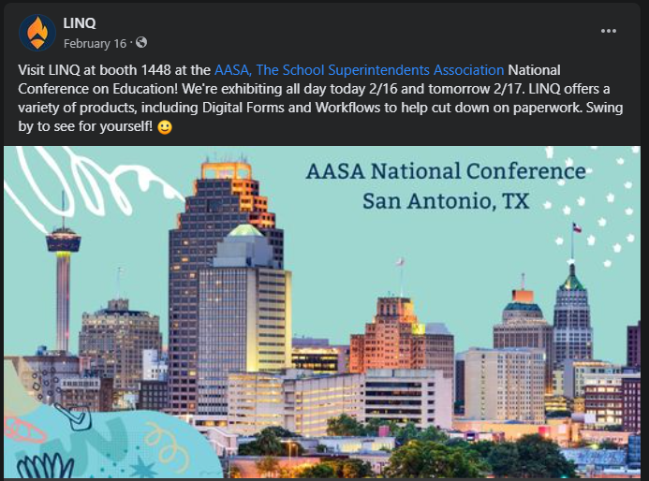
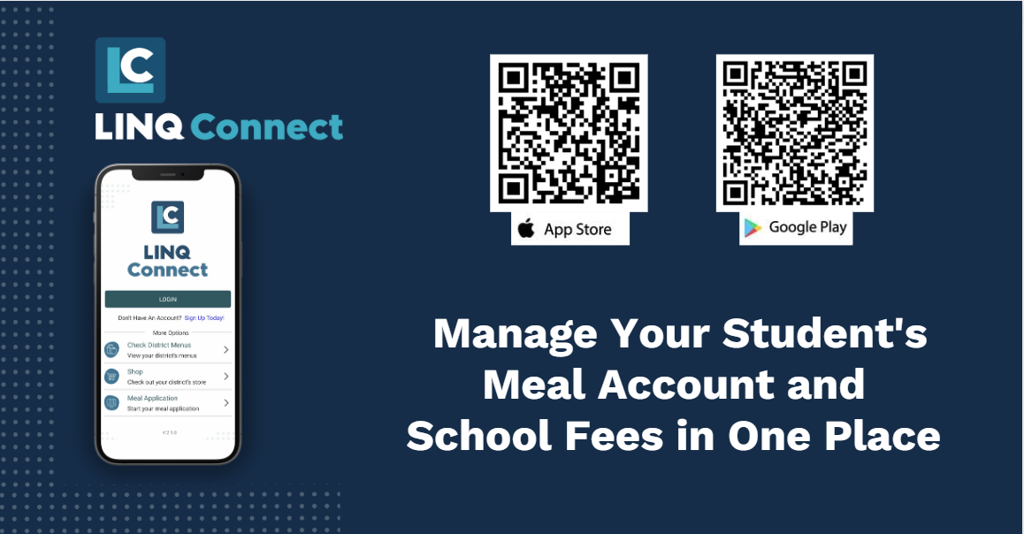
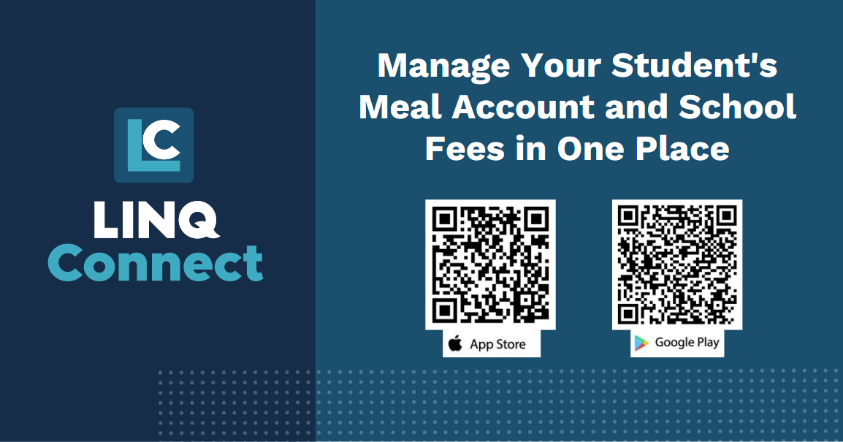
Social Media Script #1
Fees
Copy: Get ready for the new school year with the hassle-free solution eliminating the need for cash transactions, LINQ Connect! Whether it's meal account payments or school fees such as school swag, yearbooks, field trips and more, LINQ Connect has you covered this school year. #LINQConnect #K12payments #BackToSchool
Hastags: #LINQConnect #K12payments #BackToSchool
Image:
Get ready for the new school year with the hassle-free solution eliminating the need for cash transactions, LINQ Connect! Whether it's meal account payments or school fees such as school swag, yearbooks, field trips and more, LINQ Connect has you covered this school year. #LINQConnect #K12Payments
TBD
URL LINK: https://linqconnect.com

Slide 3
Social Media Script #1
No Fees
Copy: Get ahead of the game and make the upcoming school year a breeze by utilizing the convenience of LINQ Connect - the ultimate payment platform for all your school-related expenses. #LINQConnect #K12payments #BackToSchool
Hastags: #LINQConnect #K12payments #BackToSchool
Image:
Get ready for the new school year with the hassle-free solution eliminating the need for cash transactions, LINQ Connect! Whether it's meal account payments or school fees such as school swag, yearbooks, field trips and more, LINQ Connect has you covered this school year. #LINQConnect #K12Payments
TBD
URL LINK: https://linqconnect.com

Slide 4
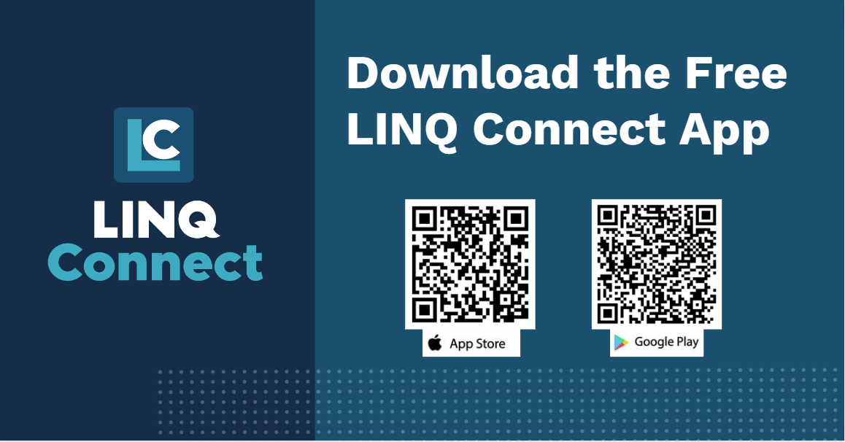
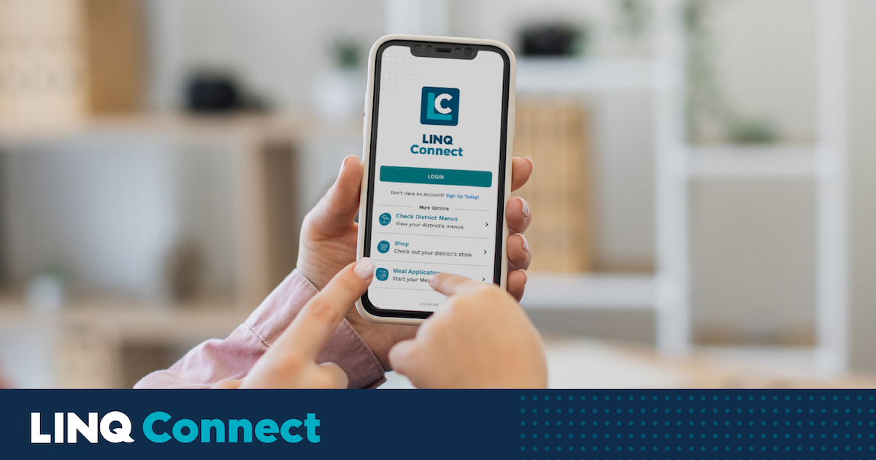
Social Media Script #2
Copy: Be sure to download the LINQ Connect App before school starts. The benefits of LINQ Connect are:
-Real-Time Connectivity
-Easy Way to Add Funds to Meal Accounts
-Meal Applications and Status Updates
-Low Balance Notifications
-School Lunch Menus #LINQConnect #K12payments #BackToSchool
Hastags: #LINQConnect #K12payments #BackToSchool
Image:
Be sure to download the LINQ Connect App before school starts. The benefits of LINQ Connect are:
-Real-Time Connectivity
-Easy Way to Add Funds to Meal Accounts
-Meal Applications and Status Updates
-Low Balance Notifications -School Lunch Menus #LINQConnect #K12payments #BackToSchool
URL LINK: https://linqconnect.com

Slide 5
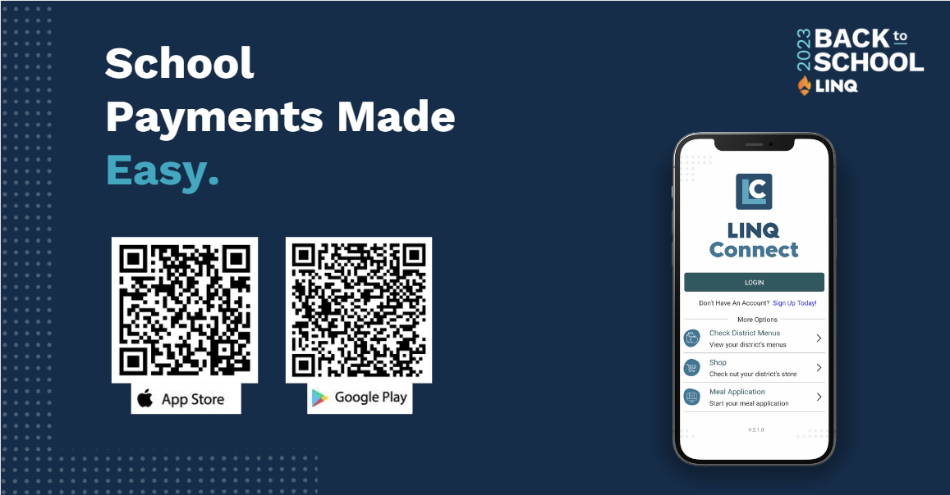
Social Media Script #3
Copy:
We’ve partnered up with LINQ Connect to offer you a safe, secure and easy way to make online meal payments. With LINQ Connect at your fingertips, you have one less thing to worry about this school year. #BackToSchool #LINQConnect #K12payments
Hastags: #LINQConnect #K12payments #BackToSchool
Image:
We’ve partnered up with LINQ Connect to offer you a safe, secure and easy way to make online meal payments. With LINQ Connect at your fingertips, you have one less thing to worry about this school year. #BackToSchool #LINQConnect #K12payments
TBD
URL LINK: https://linqconnect.com

